Slide 1
Machine Learning -
Basic Principles & Practice
10. Linear Classifiers for Nonlinear Classification
机器学习 - 基础原理与实践
10. 进行非线性分类的线性分类器
Cong Li 李聪

Slide 2
Linear & Nonlinear
线性与非线性
We Know Linear Classifiers Now
我们现在已学习了线性分类器了
  Perceptron 感知器
  Logistic regression 对数几率回归
What If We Encounter Nonlinear Classification Problems？
当我们遇上非线性问题时会怎样？
  Let’s start from 2 synthetic problems
  让我们从两个人造问题开始

Slide 3

Synthetic Problem 1 人造问题1
2 attributes 两个属性$−2≤x_{1},x_{2}≤2$
$$\left(x_{1}−0.2\right)\left(x_{1}+3\right)−x_{2}≥0→y=1$$
$$\left(x_{1}−0.2\right)\left(x_{1}+3\right)−x_{2}<0→y=−1$$

Slide 4

Practice 10.1 实践10.1
Practice time: try perceptron algorithm on the problem
实践时刻：在这个问题上尝试感知器算法
How does it perform? 它的表现如何？

Slide 5
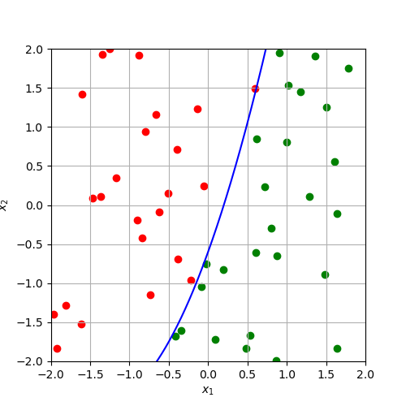
Nonlinear Problem
非线性问题
This is a nonlinear classification problem
这的确是一个非线性分类问题

Slide 6
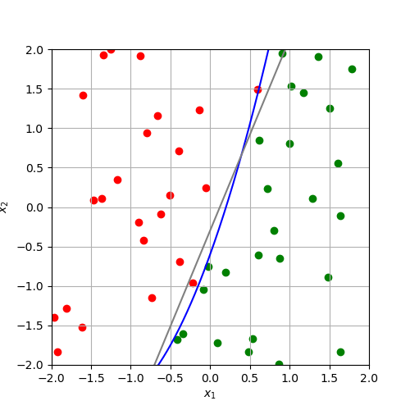
Nonlinear Problem
非线性问题
But the linear classifier performs decently
但这个线性分类器表现得很不错

Slide 7
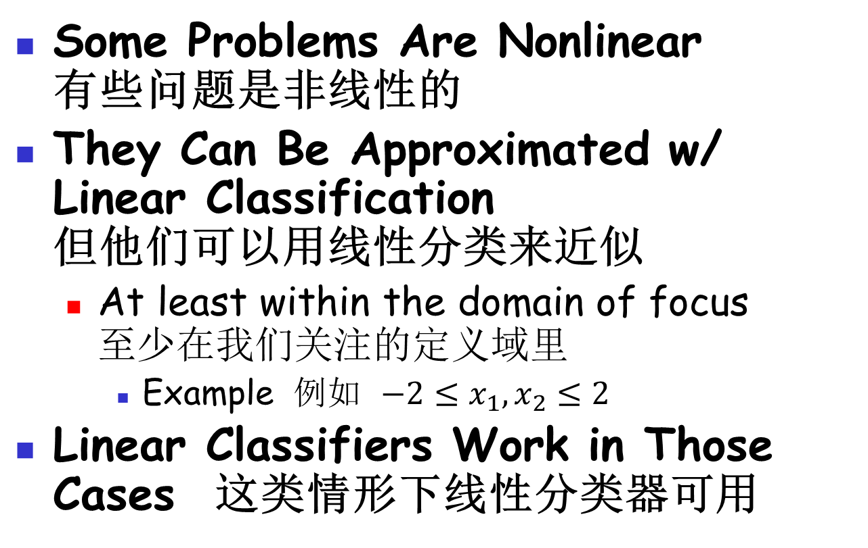
Linear Approximation 线性近似
Some Problems Are Nonlinear
有些问题是非线性的
They Can Be Approximated w/ Linear Classification
但他们可以用线性分类来近似
  At least within the domain of focus
  至少在我们关注的定义域里
    Example 例如 $−2≤x_{1},x_{2}≤2$
Linear Classifiers Work in Those Cases 这类情形下线性分类器可用

Slide 8
Synthetic Problem 2 人造问题2
2 attributes 两个属性$−2≤x_{1},x_{2}≤2$
$$−0.1x_{1}+x_{1}x_{2}+0.1x_{2}≥0→y=1$$
$$−0.1x_{1}+x_{1}x_{2}+0.1x_{2}<0→y=−1$$

Slide 9
Practice 10.2 实践10.2
Practice time: try perceptron algorithm on the problem
实践时刻：在这个问题上尝试感知器算法
How does it perform? 它的表现如何？

Slide 10
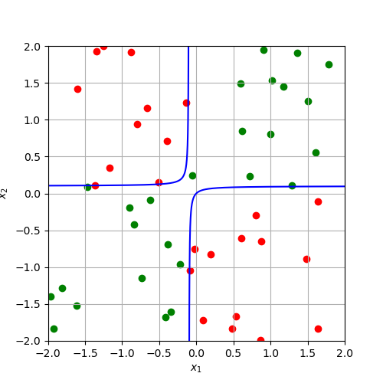
Another Nonlinear Problem
另一个非线性问题
This time things are different
这次情况不同了

Slide 11
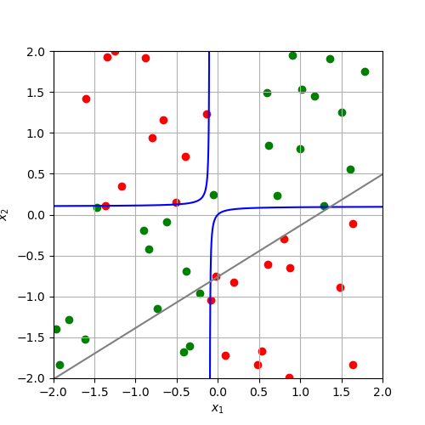
Another Nonlinear Problem
另一个非线性问题
Perceptron has already tried its best
感知器已经竭尽所能了

Slide 12
Naturally Nonlinear Problem
本质非线性问题
Some Problems Are Nonlinear in Nature 有些问题本质上是非线性的
Linear Classifiers Cannot Work
线性分类器无法处理
  The synthetic problem is an example
  这个人造问题就是一例
We Need Something Different
我们需要一些不同的方案
  Convert a nonlinear problem to a linear one 把一个非线性问题转换成线性问题

Slide 13



Transformation 变换
Idea: derive a new attribute from the existing two
想法：从已有的两个属性中衍生出一个新的属性
$$x_{3}=x_{1}x_{2}$$
Map the data samples from the original 2-dimensional space to a new higher dimensional (3-dimensional space)
把数据从原先的二维空间映射到一个更高维（三维）空间中
2D nonlinear problem
二维非线性问题
3D linear problem
三维线性问题
$$−0.1x_{1}+x_{1}x_{2}+0.1x_{2}≥0$$
$$−0.1x_{1}+0.1x_{2}+x_{3}≥0$$

Slide 14
Practice 10.3 实践10.3
Practice time: try perceptron algorithm on the transformed problem
实践时刻：在变换后的问题上尝试感知器算法
How does it perform? 它的表现如何？

Slide 15
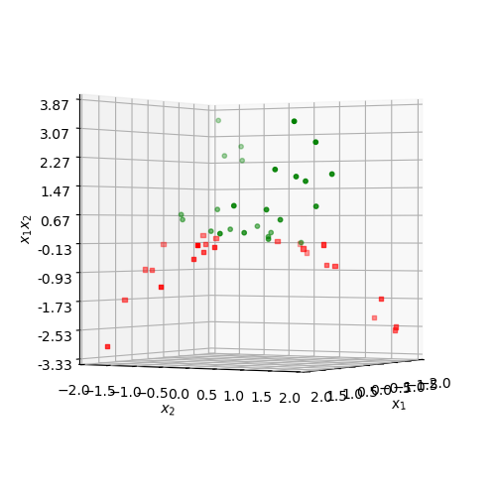
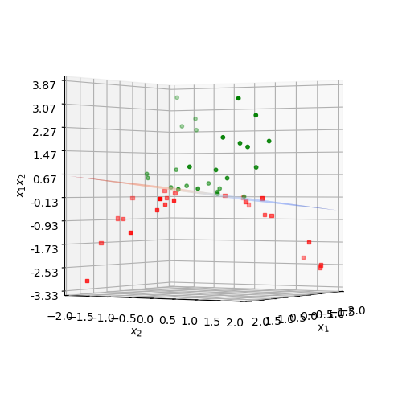
Nonlinear → Linear
非线性 → 线性

Slide 16
Practical or Impractical?
实用不实用？
The Specific Solution Is Impractical 这个特定的解决方法不实用
  We know the classification boundary
  我们知道了分类边界
  Then introduce the exact feature map
  然后引入了一致的特征映射
Practical Solution 实用的解决方案
  Create a lot of new attributes
  创造出很多新的属性
  Learn from them 从中学习

Slide 17
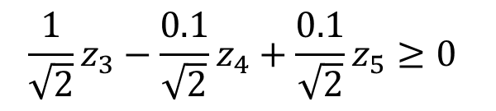

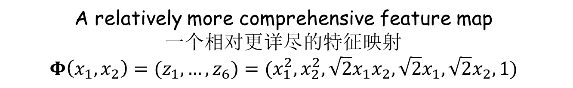
Still the Example
依然是这个例子
A relatively more comprehensive feature map
一个相对更详尽的特征映射
$$Φ\left(x_{1},x_{2}\right)=(z_{1},…,z_{6})=(x_{1}^{2},x_{2}^{2},\sqrt{2}x_{1}x_{2},\sqrt{2}x_{1},\sqrt{2}x_{2},1)$$
After mapping, the new problem in the 6-dimensional space is still linear
经过了映射，在这个六维空间中的新问题还是线性的
2D nonlinear problem
二维非线性问题
6D linear problem
六维线性问题
$$\frac{1}{\sqrt{2}}z_{3}−\frac{0.1}{\sqrt{2}}z_{4}+\frac{0.1}{\sqrt{2}}z_{5}≥0$$
$$−0.1x_{1}+x_{1}x_{2}+0.1x_{2}≥0$$
But the feature map also allows for other complicated problem
但这个特征映射也能处理其他的复杂的问题

Slide 18
Comprehensive Feature Map
详尽的特征映射
Comprehensive Feature Map
详尽的特征映射
  Introduce potentially useful attributes
  引入了有潜在用途的属性
More Comprehensive 更详尽
  More likely to make the new problem linear 更可能使得新问题变得线性化
    Cost of the curse of dimensionality
    代价是维度的诅咒
    Higher computation cost 更高的计算代价
      We solve this problem first 我们先解决这个问题

Slide 19
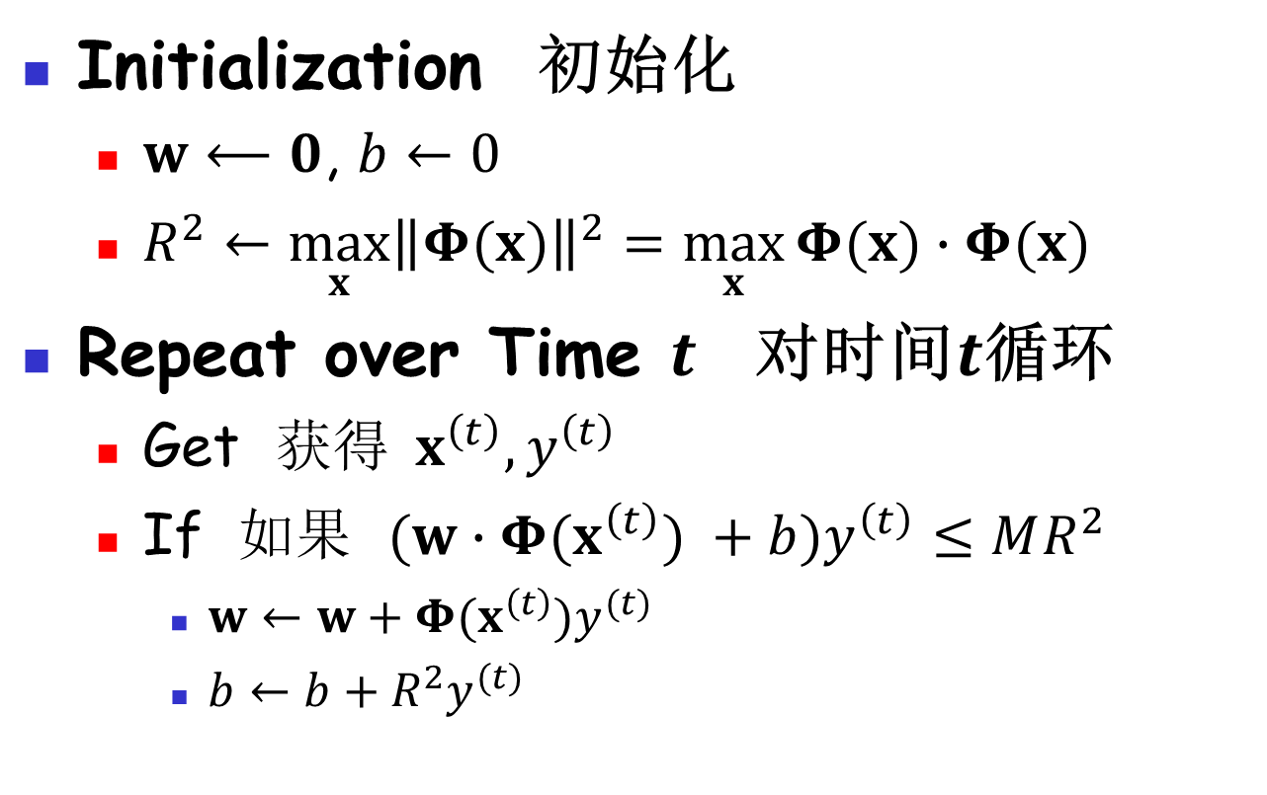
Recall Perceptron Algorithm
回忆感知器算法
Initialization 初始化
  $w⟵0$, $b←0$
  $R^{2}←\max_{x}{{\left\|Φ(x)\right\|}^{2}}=\max_{x}{Φ(x)∙Φ(x) }$
Repeat over Time $t$ 对时间$t$循环
  Get 获得$x^{\left(t\right)},y^{\left(t\right)}$
  If 如果 $(w∙Φ(x^{\left(t\right)}) +b)y^{\left(t\right)}≤MR^{2}$
    $w←w+Φ(x^{\left(t\right)})y^{(t)}$
    $b←b+{R^{2}y}^{(t)}$
Mapped to a new high dimensional space
映射到了新的高维空间

Slide 20

Recall Perceptron Algorithm
回忆感知器算法
Initialization 初始化
  $w⟵0$, $b←0$
  $R^{2}←\max_{x}{{\left\|Φ(x)\right\|}^{2}}=\max_{x}{Φ(x)∙Φ(x) }$
Repeat over Time $t$ 对时间$t$循环
  Get 获得$x^{\left(t\right)},y^{\left(t\right)}$
  If 如果 $(w∙Φ(x^{\left(t\right)}) +b)y^{\left(t\right)}≤MR^{2}$
    $w←w+Φ(x^{\left(t\right)})y^{(t)}$
    $b←b+{R^{2}y}^{(t)}$
Update of $w$
$w$的改动

Slide 21



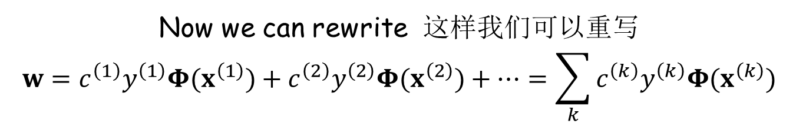
Rewrite the Weights 重写权重
Initialization 初始化
$$w=0$$
Update w/ the condition satisfied 条件满足时的更新
$$w←w+Φ(x^{\left(t\right)})y^{(t)}$$
$w i$s a combination of $Φ(x^{\left(t\right)})$ $w$是$Φ(x^{\left(t\right)})$的组合
Let $c^{(t)}$ denote whether we update $w$ at time $t$
用$c^{(t)}$表示我们是否在$t$时刻更新了$w$
Now we can rewrite 这样我们可以重写
$$w=c^{\left(1\right)}y^{\left(1\right)}Φ(x^{\left(1\right)})+c^{\left(2\right)}y^{\left(2\right)}Φ{(x}^{\left(2\right)})+…=\sum_{k}{c^{\left(k\right)}y^{\left(k\right)}Φ{(x}^{\left(k\right)})}$$

Slide 22
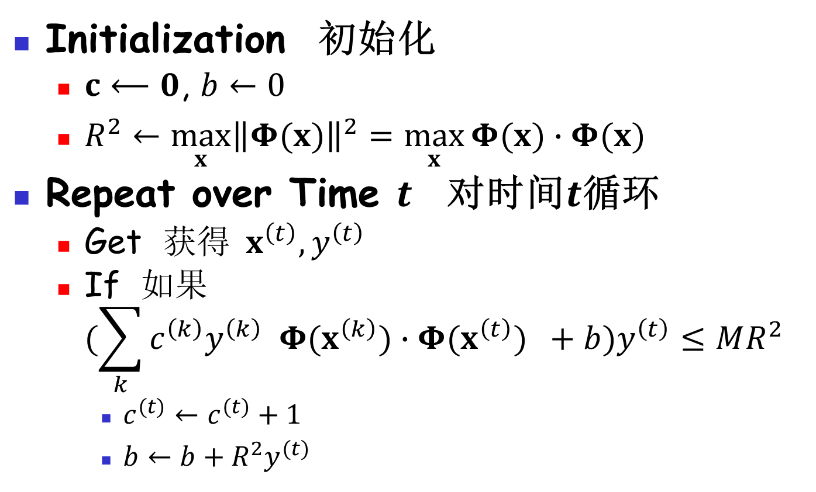
Rewrite the Algorithm 重写算法
Initialization 初始化
  $c⟵0$, $b←0$
  $R^{2}←\max_{x}{{\left\|Φ(x)\right\|}^{2}}=\max_{x}{Φ(x)∙Φ(x) }$
Repeat over Time $t$ 对时间$t$循环
  Get 获得$x^{\left(t\right)},y^{\left(t\right)}$
  If 如果
  $(\sum_{k}{c^{\left(k\right)}y^{\left(k\right)} Φ{(x}^{\left(k\right)})}∙Φ(x^{\left(t\right)}) +b)y^{\left(t\right)}≤MR^{2}$
    $c^{(t)}←c^{(t)}+1$
    $b←b+{R^{2}y}^{(t)}$

Slide 23
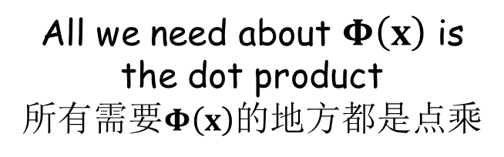

Rewrite the Algorithm 重写算法
Initialization 初始化
  $c⟵0$, $b←0$
  $R^{2}←\max_{x}{{\left\|Φ(x)\right\|}^{2}}=\max_{x}{[Φ\left(x\right)∙Φ\left(x\right)] }$
Repeat over Time $t$ 对时间$t$循环
  Get 获得$x^{\left(t\right)},y^{\left(t\right)}$
  If 如果
  $(\sum_{k}{c^{\left(k\right)}y^{\left(k\right)}}[Φ{(x}^{\left(k\right)})∙Φ(x^{\left(t\right)})]+b)y^{\left(t\right)}≤MR^{2}$
    $c^{(t)}←c^{(t)}+1$
    $b←b+{R^{2}y}^{(t)}$
All we need about $Φ\left(x\right)$ is the dot product
所有需要$Φ\left(x\right)$的地方都是点乘

Slide 24
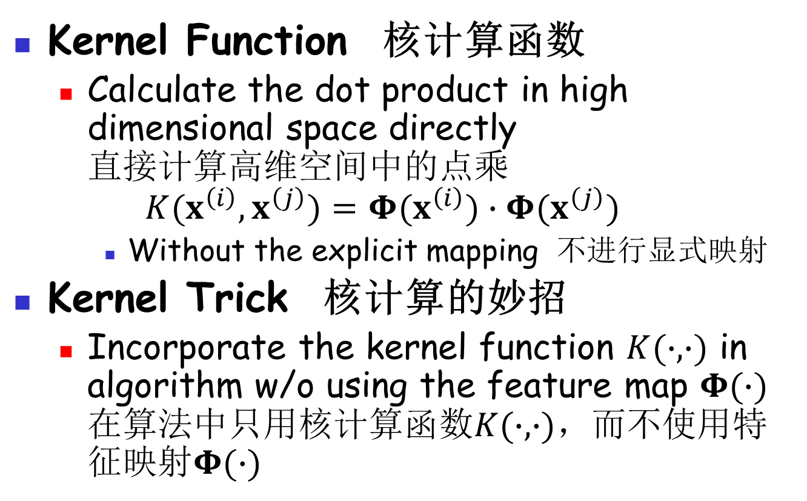
Kernel Trick 核计算的妙招
Kernel Function 核计算函数
  Calculate the dot product in high dimensional space directly
  直接计算高维空间中的点乘
  $$K(x^{\left(i\right)},x^{\left(j\right)})=Φ{(x}^{\left(i\right)})∙Φ(x^{\left(j\right)})$$
    Without the explicit mapping 不进行显式映射
Kernel Trick 核计算的妙招
  Incorporate the kernel function $K(∙,∙)$ in algorithm w/o using the feature map $Φ(∙)$
  在算法中只用核计算函数$K(∙,∙)$，而不使用特征映射$Φ(∙)$

Slide 25
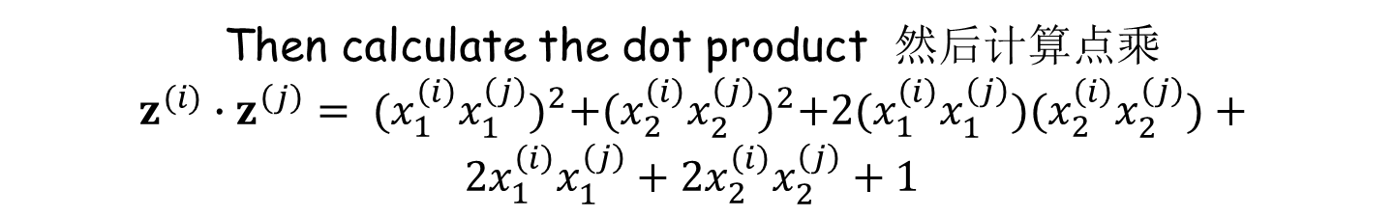
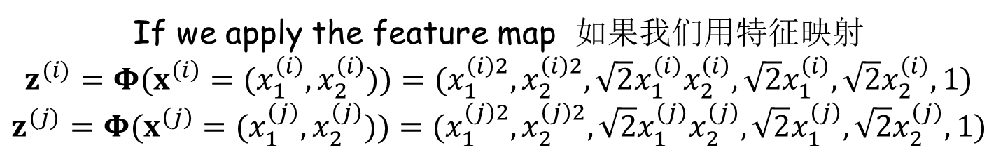


Kernel Example 核计算的例子
$$z=Φ\left(x={(x}_{1},x_{2})\right)= (x_{1}^{2},x_{2}^{2},\sqrt{2}x_{1}x_{2},\sqrt{2}x_{1},\sqrt{2}x_{2},1)$$
We encounter 我们遇到
$x^{(i)}=(x_{1}^{\left(i\right)},x_{2}^{\left(i\right)})$ & $x^{(j)}=(x_{1}^{\left(j\right)},x_{2}^{\left(j\right)})$
If we apply the feature map 如果我们用特征映射
$z^{(i)}=Φ(x^{\left(i\right)}=(x_{1}^{\left(i\right)},x_{2}^{\left(i\right)}))=(x_{1}^{\left(i\right)2},x_{2}^{\left(i\right)2},\sqrt{2}x_{1}^{\left(i\right)}x_{2}^{\left(i\right)},\sqrt{2}x_{1}^{\left(i\right)},\sqrt{2}x_{2}^{\left(i\right)},1)$
$$z^{(j)}=Φ(x^{\left(j\right)}=(x_{1}^{\left(j\right)},x_{2}^{\left(j\right)}))=(x_{1}^{\left(j\right)2},x_{2}^{\left(j\right)2},\sqrt{2}x_{1}^{\left(j\right)}x_{2}^{\left(j\right)},\sqrt{2}x_{1}^{\left(j\right)},\sqrt{2}x_{2}^{\left(j\right)},1)$$
Then calculate the dot product 然后计算点乘
$$z^{(i)}∙z^{\left(j\right)}= {(x_{1}^{\left(i\right)}x_{1}^{\left(j\right)})}^{2}+{(x_{2}^{\left(i\right)}x_{2}^{\left(j\right)})}^{2}+2(x_{1}^{\left(i\right)}x_{1}^{\left(j\right)})(x_{2}^{\left(i\right)}x_{2}^{\left(j\right)})+$$
$2x_{1}^{\left(i\right)}x_{1}^{\left(j\right)}+2x_{2}^{\left(i\right)}x_{2}^{\left(j\right)}+1$
$$={(x_{1}^{\left(i\right)}x_{1}^{\left(j\right)}+x_{2}^{\left(i\right)}x_{2}^{\left(j\right)}+1)}^{2}$$

Slide 26


Kernel Example 核计算的例子
$$z=Φ\left(x={(x}_{1},x_{2})\right)= (x_{1}^{2},x_{2}^{2},\sqrt{2}x_{1}x_{2},\sqrt{2}x_{1},\sqrt{2}x_{2},1)$$
We encounter 我们遇到
$x^{(i)}=(x_{1}^{\left(i\right)},x_{2}^{\left(i\right)})$ & $x^{(j)}=(x_{1}^{\left(j\right)},x_{2}^{\left(j\right)})$
If we use the kernel function 如果我们核计算函数
$$K(x^{\left(i\right)},x^{\left(j\right)})={(x^{\left(i\right)}∙x^{\left(j\right)}+1)}^{2}$$
Then dot product becomes 然后点乘变成
$$z^{(i)}∙z^{\left(j\right)}=K(x^{\left(i\right)},x^{\left(j\right)})={(x_{1}^{\left(i\right)}x_{1}^{\left(j\right)}+x_{2}^{\left(i\right)}x_{2}^{\left(j\right)}+1)}^{2}$$
Computation cost saved 节省了计算代价

Slide 27

Kernel Perceptron
核计算感知器
Initialization 初始化
  $c⟵0$, $b←0$
  $R^{2}←\max_{x}{{\left\|Φ(x)\right\|}^{2}}=\max_{x}{K(x,x) }$
Repeat over Time $t$ 对时间$t$循环
  Get 获得$x^{\left(t\right)},y^{\left(t\right)}$
  If 如果
  $(\sum_{k}{c^{\left(k\right)}y^{\left(k\right)}K(x^{\left(k\right)},x^{\left(t\right)}) }+b)y^{\left(t\right)}≤MR^{2}$
    $c^{(t)}←c^{(t)}+1$
    $b←b+{R^{2}y}^{(t)}$

Slide 28
Practice 10.4 实践10.4
Practice time: try the kernel perceptron algorithm
实践时刻：尝试核计算感知器算法
How does it perform? 它的表现如何？

Slide 29
Cost Saving 节约代价
Cost Saved in the Example
这个例子中节约的代价
  Not significant 不算太大
Cost Saved in Real World Problem
真实问题中节约的代价
  Can be very significant 会非常大
    Many cannot work w/o a kernel
    很多情况下没有核计算就无法进行
  We look at 2 commonly used kernels
  我们来看看两个常用的核计算

Slide 30
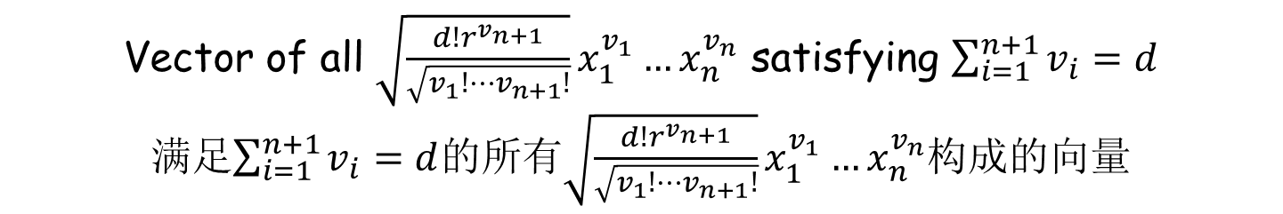


Polynomial Kernel
多项式核计算
A commonly used kernel 一个常用的核计算
$$K(x^{\left(i\right)},x^{\left(j\right)})=({x^{\left(i\right)}∙x^{\left(j\right)}+r)}^{d}$$
The feature map 特征映射
$$Φ(x)={(\sqrt{\frac{d!r^{v_{n+1}}}{\sqrt{v_{1}!⋯v_{n+1}!}}}x_{1}^{v_{1}}…x_{n}^{v_{n}})}_{\sum_{i=1}^{n+1}{v_{i}}=d}$$
Vector of all $\sqrt{\frac{d!r^{v_{n+1}}}{\sqrt{v_{1}!⋯v_{n+1}!}}}x_{1}^{v_{1}}…x_{n}^{v_{n}}$ satisfying $\sum_{i=1}^{n+1}{v_{i}}=d$
满足$\sum_{i=1}^{n+1}{v_{i}}=d$的所有$\sqrt{\frac{d!r^{v_{n+1}}}{\sqrt{v_{1}!⋯v_{n+1}!}}}x_{1}^{v_{1}}…x_{n}^{v_{n}}$构成的向量
The dimension of the new space is very high 新空间的维度很高

Slide 31
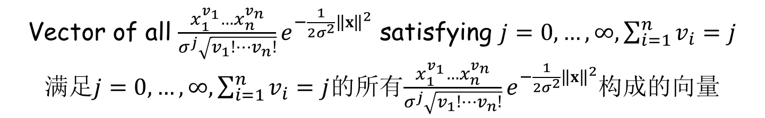


Radius Basis Function Kernel
径向基函数核计算
The most commonly used kernel 最常用的核计算
$$K(x^{\left(i\right)},x^{\left(j\right)})=e^{−\frac{1}{2σ^{2}}{\left\|x^{\left(i\right)}−x^{\left(j\right)}\right\|}^{2}}$$
The feature map 特征映射
$$Φ(x)={(\frac{x_{1}^{v_{1}}…x_{n}^{v_{n}}}{σ^{j}\sqrt{v_{1}!⋯v_{n}!}}e^{−\frac{1}{2σ^{2}}{\left\|x\right\|}^{2}})}_{j=0,…,∞,\sum_{i=1}^{n}{v_{i}}=j}$$
Vector of all $\frac{x_{1}^{v_{1}}…x_{n}^{v_{n}}}{σ^{j}\sqrt{v_{1}!⋯v_{n}!}}e^{−\frac{1}{2σ^{2}}{\left\|x\right\|}^{2}}$ satisfying $j=0,…,∞,\sum_{i=1}^{n}{v_{i}}=j$
满足$j=0,…,∞,\sum_{i=1}^{n}{v_{i}}=j$的所有$\frac{x_{1}^{v_{1}}…x_{n}^{v_{n}}}{σ^{j}\sqrt{v_{1}!⋯v_{n}!}}e^{−\frac{1}{2σ^{2}}{\left\|x\right\|}^{2}}$构成的向量
The dimension of the new space is infinite 新空间的维度是无穷大

Slide 32
Kernel 核计算
Most Practical Feature Map
大多数实用的特征映射
  Map to a very high or even infinite dimensional space
  映射到的空间维度非常高或甚至是无穷大
  Calculation is intractable w/o a kernel
  没有核计算，直接计算是不现实的
Curse of Dimensionality 维度的诅咒
  Alleviated by the margin
  用间距来缓解这个问题

Slide 33
Practice 10.5 实践10.5
Practice time: try the original perceptron algorithm on handwritten ZIP code recognition
实践时刻：尝试用原感知器算法进行手写邮政编码识别
How does it perform? 它的表现如何？

Slide 34
Practice 10.6 实践10.6
Practice time: try the kernel perceptron algorithm on handwritten ZIP code recognition
实践时刻：尝试用核计算感知器算法进行手写邮政编码识别
How does it perform? 它的表现如何？

Slide 35
Results 结果
Methods 方法 | Error rate 错误率
Nearest neighbor 最近邻 | 4.98%
Linear perceptron 线性感知器 | 8.52%
Perceptron – RBF 感知器 – 径向基函数核计算 | 4.43%
Perceptron – Polynomial 感知器 – 多项式核计算 | 4.24%

Slide 36
The End

